Slide 1

STOCK MARKET ANALYSIS
SHRADHA | RUPALI | AYMA | NEHA
SATYENDRA
MENTORS : ANAND BABU | SMITHA BANTWAL

Slide 2




KEY CONTENTS
KPI’s
Analyzing Key performance indicators to provide crucial aspects of stock performance and decipher valuable insights
CHALLENGES | INSIGHTS
Explored datasets to curate valuable insights based on specific KPI’s
INTRODUCTION
To provide insights into the stock market performance of selected major companies. To identify patterns, trends, and anomalies in the stock’s behaviour over time.
DASHBOARDS
Overall analysis curated through the dashboards using excel, tableau and Power BI

Slide 3
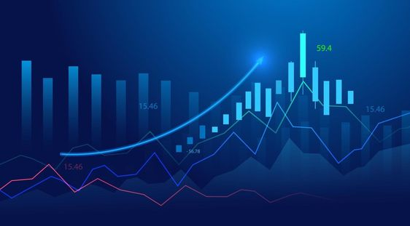
INTRODUCTION
This presentation introduces the world of stock market performance, shedding light on its importance and key elements.
It covers metrics like stock indices, market capitalization, and volatility while explaining the concepts of bull and bear markets.
The influence of economic indicators, corporate earnings, and global events on market behavior is explored.
The significance of diversified sectors and historical performance analysis is highlighted.
The presentation also touches on investor sentiment, acknowledging challenges and risks such as market corrections and behavioral biases.
Lastly, it discusses adapting to emerging trends, strategic investment approaches, and the enduring value of a long-term perspective for investors.

Slide 4
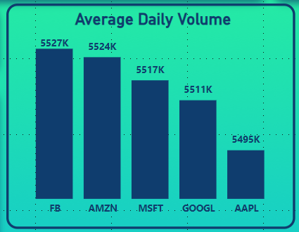
KPI 1- AVERAGE DAILY TRADING VOLUME
OBSERVATION
FB has the highest Average Trading Volume.
AAPL has the lowest Average Trading Volume.
FBJO
CONCLUSION
It indicates the level of liquidity in the market. In this specific dataset:
.FB indicates that buying and selling shares can be done with ease without significantly affecting the stock's price. it is highly liquid.
AAPL indicates that buying or selling shares of AMZN might have a more significant impact on its stock price. It has lower liquidity.

Slide 5
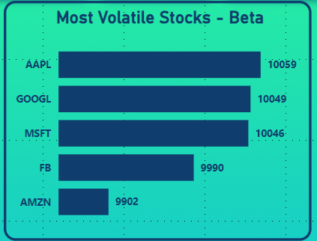
KPI 2- MOST VOLATILE STOCKS
OBSERVATION
AAPL has the highest Beta Value.
AMZN has the lowest Beta Value.
CONCLUSION
Beta is a measure of a stock’s price sensitivity to market movement:
AAPL is more volatile and has higher price sensitivity to market movement. Investors should be aware that higher volatility can lead to larger price fluctuation, both upward and downward.
AMZN is less volatile and has lower price sensitivity to market movements. The stock price is expected to be less affected by general market fluctuations. While this can offer a more stable investment, it may also mean potentially lower returns during strong market upswings.

Slide 6
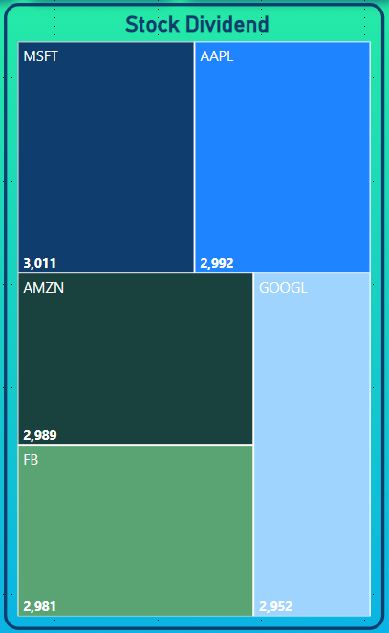
KPI 3- STOCK WISE DIVIDENT AMOUNT
OBSERVATION
MFST has given more dividend amounts.
GOOGLE has given the least dividend amount.
CONCLUSION
MICROSOFT is sharing more of its profit with its investors compared to AAPL, AMZN, FB, and Google,

Slide 7
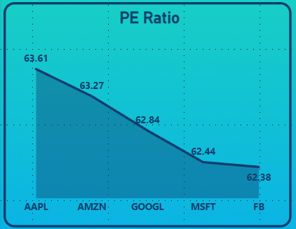
KPI 4- STOCK WISE P/E RATIO
OBSERVATION
AAPL has the highest P/E Ratio.
FB has the lowest P/E Ratio.
CONCLUSION
All the companies have relatively high average P/E ratios indicating that investors are willing to pay a premium for their stocks and these companies have a lot of potential for growth and earnings, making them attractive to investors.
u

Slide 8
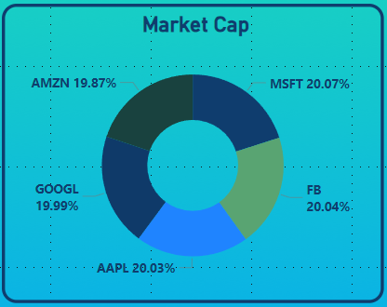
KPI 5- STOCK WISE MARKET CAP
OBSERVATION
AMZN, FB, MSFT, AAPL and Google are seen as very close in values.
MFST – Highest Market Cap
AMZN – Lowest Market Cap
CONCLUSION
Amongst the companies, MFST has the highest perceived value at 20.07%.
MFST is currently holding the top spot in terms of market capitalization in the chart.
This reflects positive investor confidence in the overall strength of the tech industry amidst favorable market conditions.
u

Slide 9
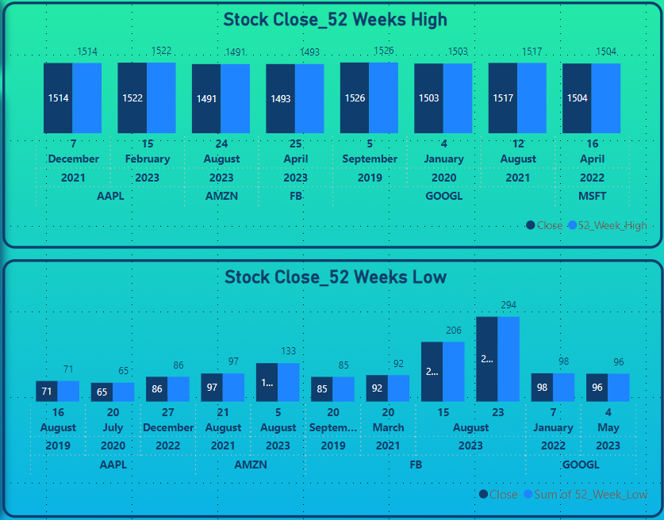
KPI 6 & 7- STOCKWISE 52 WEEK HIGH AND LOW
OBSERVATION
Stocks near 52-week high: Stocks close to their 52-week high might be experiencing strong bullish trends, indicating positive market sentiment.
Stocks near 52-week low: Stocks close to their 52-week low may be underperforming or facing negative sentiment, potentially presenting buying opportunities if a turnaround is anticipated
All the companies have almost the same 52-week high and 52-week low stock prices
CONCLUSION
Analyzing stocks near their 52-week highs and lows can provide valuable insights into market trends and potential investment opportunities or risks.
u

Slide 10
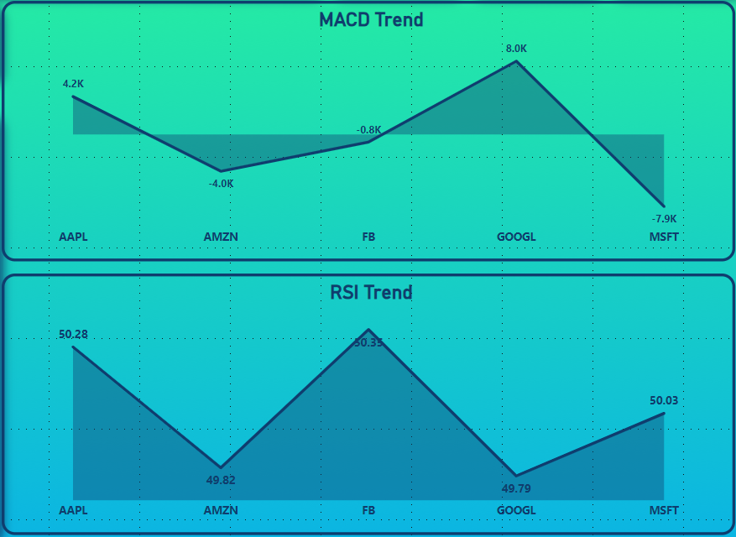
KPI 8- BUY/ WAIT/ SELL SIGNAL FOR STOCKS
OBSERVATION
RSI (Relative Strength Index): A high RSI indicates potential overbought conditions, suggesting a sell signal, while a low RSI indicates potential oversold conditions, suggesting a buy signal.
MACD (Moving Average Convergence Divergence): When the MACD line crosses above the signal line, it indicates a bullish trend (buy signal), and when it crosses below, it indicates a bearish trend (sell signal).
CONCLUSION
Combining RSI and MACD indicators provides a comprehensive view of market momentum and potential reversal points, enhancing decision-making for buy or sell signals.
u

Slide 11
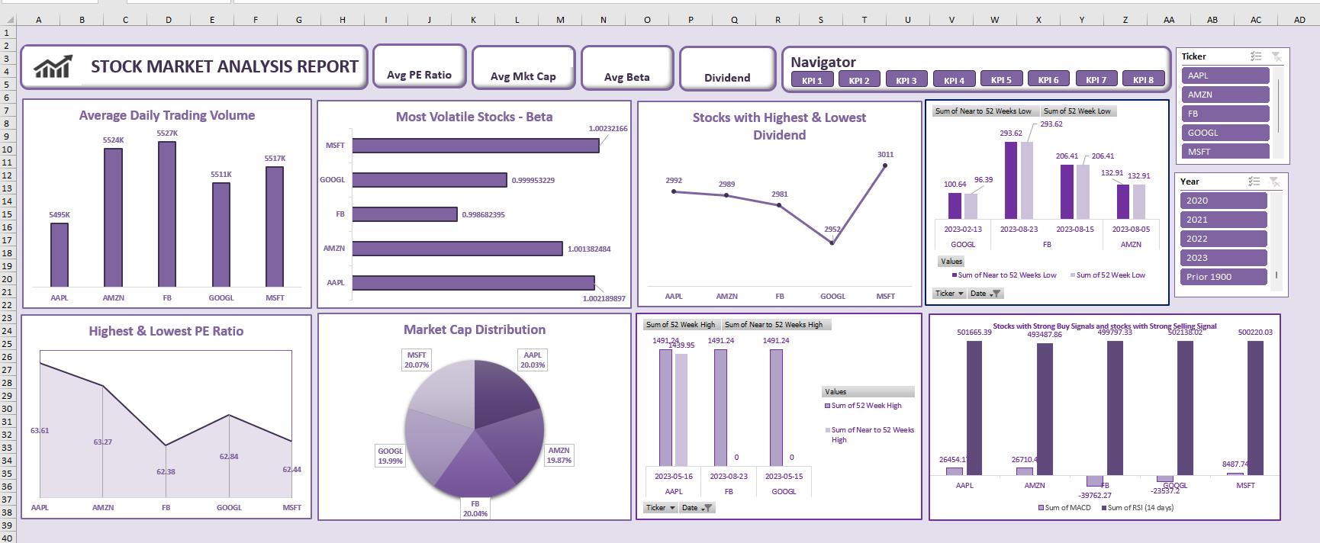
DASHBOARD - EXCEL

Slide 12
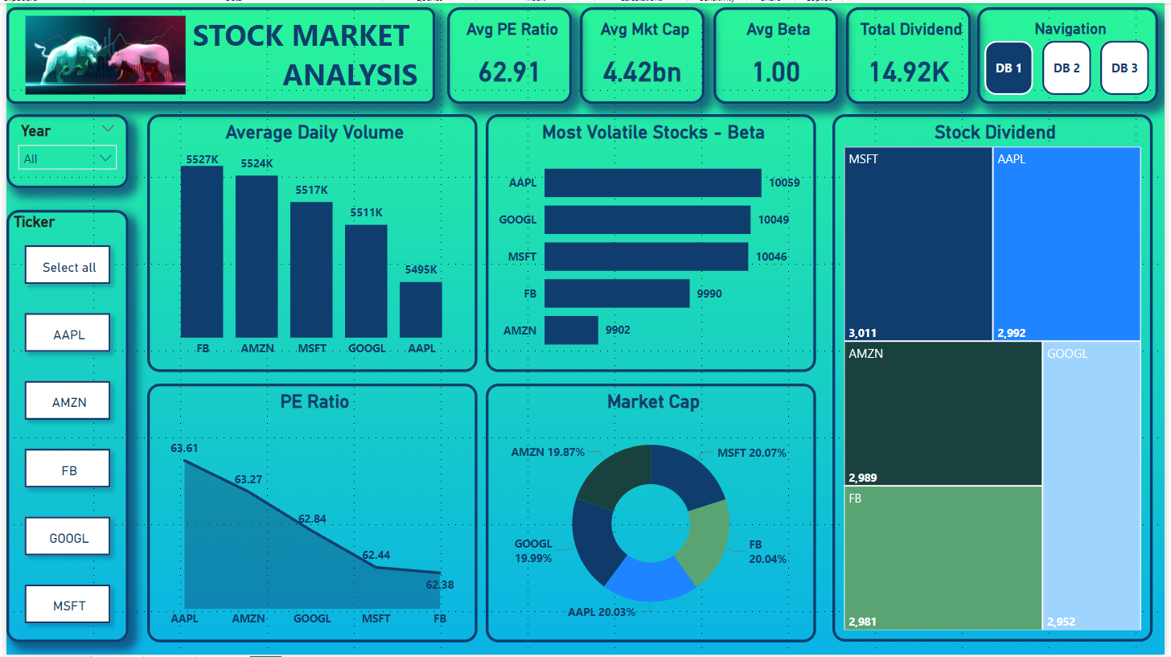
DASHBOARD – POWER BI

Slide 13
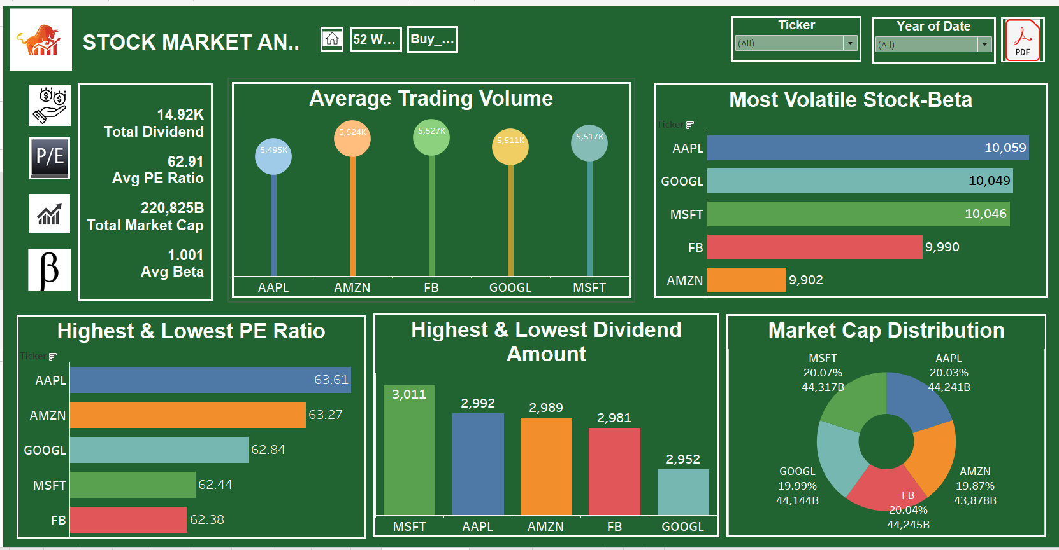
DASHBOARD – TABLEAU

Slide 14

Stock Performance Analysis
INSIGHTS
01
02
03
04
05
06
07
Market Popularity and Liquidity.
Volatility and Price Movements.
Dividend History.
Company Performance.
Amazon’s Dominance.
Google’s Relative Position.
Emphasis on Bullish Bias.
Frequent Buy Signals.
Diversification.
Risk and Returns.
Investor Sentiment.
Earnings Stability.
Potential for Opportunities.
Sector-wide Trends.

Slide 15
THANKYOU FOR YOUR TIME !
SHRADHA | RUPALI | AYMA | NEHA | SATYENDRA

